Slide 1
Manage and use PT data
National Public Health Laboratory Haiti RTCQI Workshop Panama Aug 2024 Garry Robillard, TM UEEQ/LNSP

Slide 2
Outline of the Presentation
Distribution of evaluation panels and collection of results reports
EQA Panel Distribution Chain
EQA Data Management
Use of EQA data
Lessons Learned

Slide 3
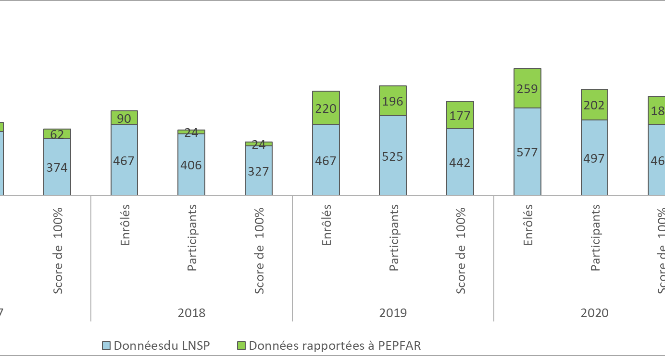
Overview of the EQA Program
The National Programme for External Quality Assessment in Haiti covers the ten geographical departments of the country. In 2023, an average of 258 laboratories participated in the program.

Slide 4
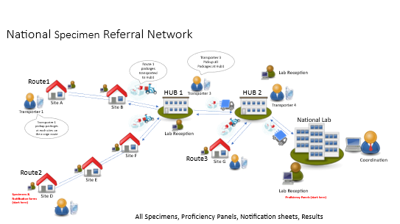
Programme Logistics Infrastructure: RNTE
Transport of panel samples
Retrieving/ Collection of Results Reports
Distribution of performance reports

Slide 5
EQE Panel Distribution Chain
EQA/LNSP
UC-RNTE
(LNSP)
Departmental
technologists
Transporters
UC-RNTE
Laboratories/
PoC services

Slide 6
Retour des comptes rendus de résultat
Laboratoires/
Points de service
Transporteurs
UC-RNTE
Technologiste
Départemental
UC-RNTE
LNSP
UEEQ/LNSP

Slide 7
Performance Report Routing
UEEQ/LNSP
UC-RNTE
(LNSP)
Technologiste
Départemental
Transporteurs
UC-RNTE
Laboratoires/
Points de service

Slide 8
EQA Data Management
Site Data Collection
Within 20 days of receipt of the panels, sites must return the results.
EQA Data Entry
The EQA team uses an excel file to facilitate data entry and analysis.
EQA Data analysis
The data analysis is done within 30 days for the return of the performance reports and the closure of the current session.
A period of no more than 15 days for data entry.

Slide 9
EQA Performance Indicators: Year 2023
Result indicators | Targets | HIV RTD
% of laboratories/service points participating | 95% | 90%
% of laboratories that returned results on time | 95% | 85%
% of laboratories with a satisfactory score | 100% | 93%
% of laboratories with improved performance | 90% | 100%

Slide 10
Analysis of results
An individual performance report including the laboratory score, technical commentary, and recommendations in case of result discrepancies
An overall report of all the laboratories evaluated including
Details of the panel samples
Expected results
The number of participating laboratories
The accuracy of the results per panel sample
Performance by department Overall performance
A general comment on the results

Slide 11
Un rapport annuel du programme :
Les détails sur les différentes distributions de panels envoyés
Taux de participation par département et par session pour chaque test en évaluation
Taux d’exactitude des résultats par échantillon du panel pour chaque test en évaluation
Taux d’exactitude des résultats par département et par session pour chaque test en évaluation
Les indicateurs de résultat permettant d’apprécier l’atteinte des objectifs fixés pour chaque test en évaluation
Une analyse globale des résultats de performance et du fonctionnement du PNEEQ
Les détails sur l’évolution du PNEEQ
Les recommandations du Comité Technique Consultatif (CTC)
Une conclusion

Slide 12
Taux de participation et d’exactitude pour le VIH Année 2023

Slide 13
Taux de participation et d’exactitude par département et par session pour le VIH

Slide 14
HIV participation and accuracy rates per session Years: 2021- 2022- 2023

Slide 15
Use of EQA program data
- An overall summary of the results supplemented by the comments of the Technical Advisory Committee
- Identify issues related to participant performance
- The drafting of the departmental performance report and sent to each Departmental Technologist.
In this report, problems related to a laboratory's performance are identified and corrective actions to be taken
- Dissemination of results at the national workshop held each year
- Recommendations/ decisions to improve laboratory performance and operations of the EQA Program

Slide 16
Lessons Learned
With the analysis of the data, the LNSP/UEEQ has a real idea of the overall performance of the laboratories for a recommendation of necessary improvements to the quality of biological examinations
EQA data are useful for planning training for laboratory staff
EQA data are needed to build on achievements and meet new challenges

Slide 17
Thank you for your attention

